Slide 1
Update: Data Analyses Tracking-Task A and B
23.09.2022

Slide 2
Preprocessing
FPz as reference electrode
Downsampling to 250 Hz
Highpass filter for 1 Hz
Remove line noise at 50 Hz
Remove bad channels (flat, minimum channel correlation)
Lowpass filter 40 Hz
Interpolate bad channels
Rereference to average
Merge data for task A & B: for ICA, epoch data, detrending, artifact rejection
run ICA (extended infomax algorithm)
Iclabel: keep only those Ics that are labelled as neural component with at least 0.5 probability
Visual checks of remaining components
Parallelize behavioral and EEG data → add triggers etc.
Epoch data: 1) for whole trial (-1 13) → baseline correction for fixcross interval (-750 0)
2) -1 4 for task A and B, later reduced to relevant time interval
Artifact rejection for segments

Slide 3
Wavelet analysis
Morlet wavelet, 5 cycles, length of wavelet kernel = 3
Frequencies: 1-35 Hz (although hp-filter for 1 Hz was applied before)
Conditions:
Task A: trajectory segments → random1, constant, rand2 excluded
Task B: occlusion segments → occluded, non-occluded/visible

Slide 4
CBPT A & B
Monte-Carlo, 1000 iterations
Alpha = 0.001, cluster alpha = 0.001
For alpha (8-12 Hz), theta (4-7 Hz) and beta band (13-30 Hz)
Excluded first 500 ms of rand1 trajectory:
2 time intervals:
until_500 = first 500 ms of constant and rand1 trajectory
After_500 = 500-3000 ms of rand1 compared to 0-2500 ms of const
Task A: averaged only in frequency dimension
Task B: averaged in both time and frequency dimension

Slide 5
Pipeline DICS Beamforming
Reduce trials to significant time windows
Calculate cross-spectral density matrix for each frequency band and each condition
Cross-spectral density matrix for appended data (both conditions)
Common spatial filter with DICS beamformer
Apply common filter to both conditions
Calculate ratio: (cond1 - cond2)/(cond1+cond2)
Grand average of ratio acros subjects
Interpolate data for MRI and plot
Until now, no mask/threshold applied!

Slide 6
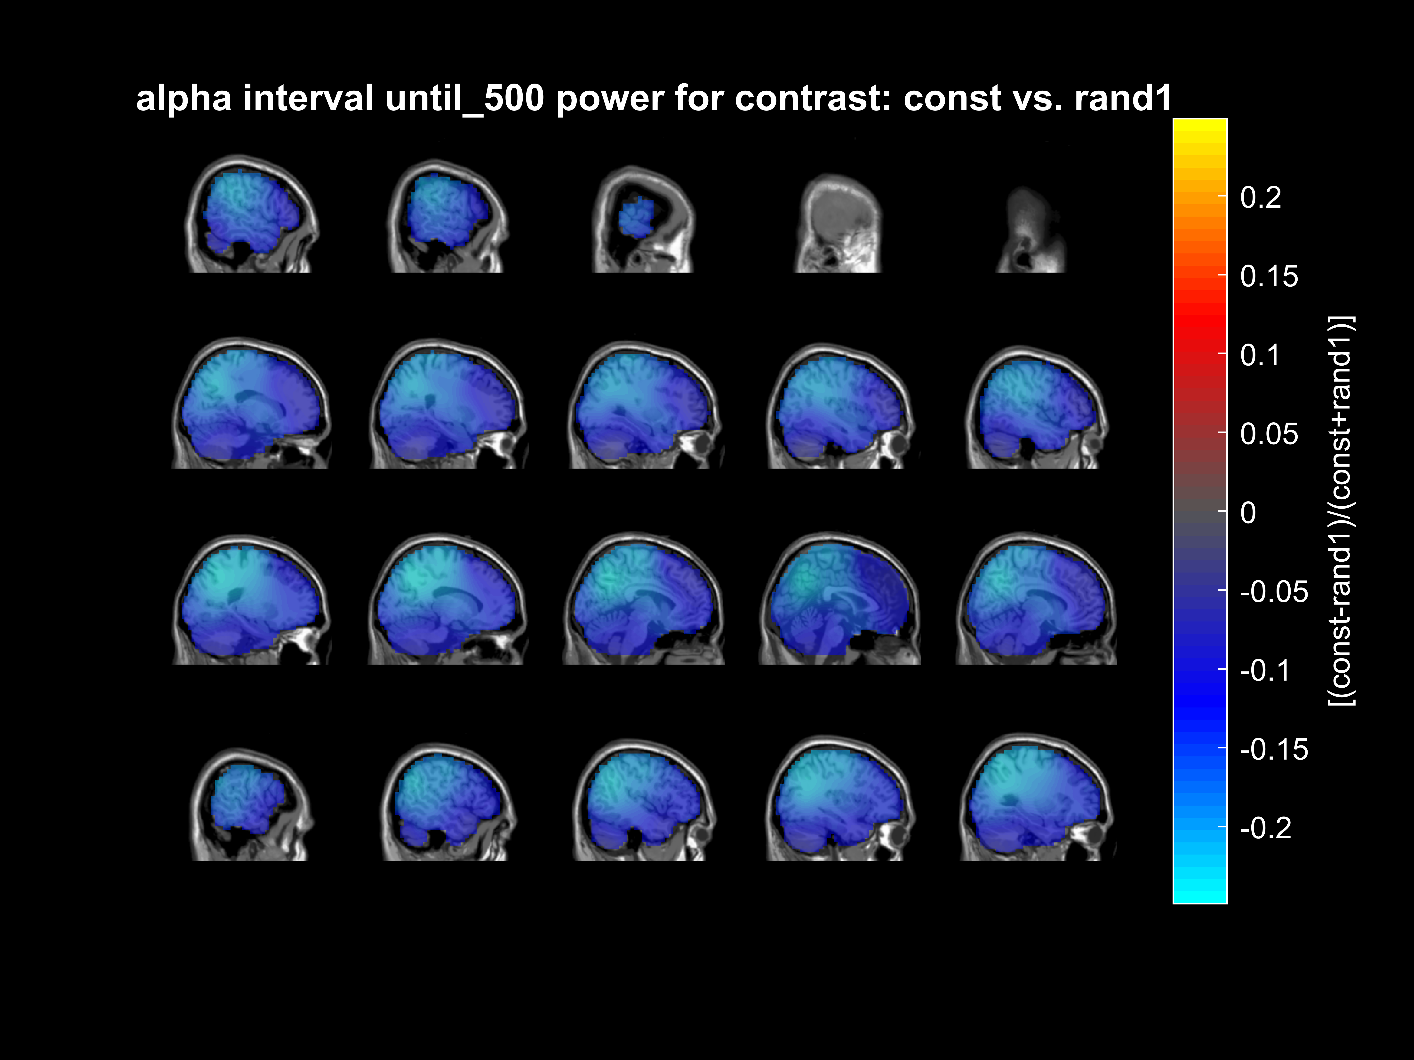
Task A: alpha power
First 500 ms significant
Significant time window: 0-0.5 s
After 500 ms no significant contrast in alpha band

Slide 7
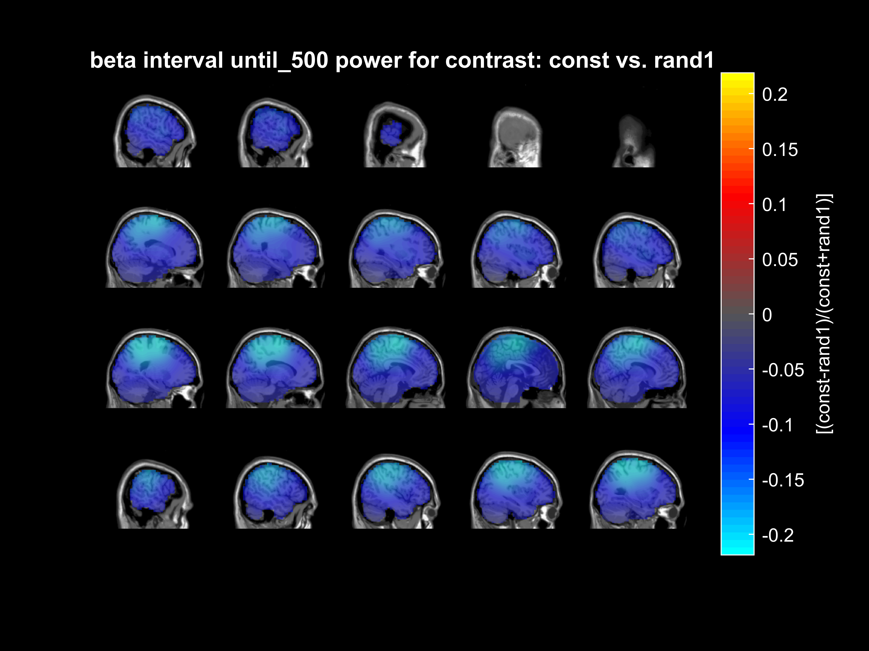
Task A: beta power
First 500 ms significant
Significant time window: 0.068-0.436 s
After 500 ms no significant contrast in beta band

Slide 8

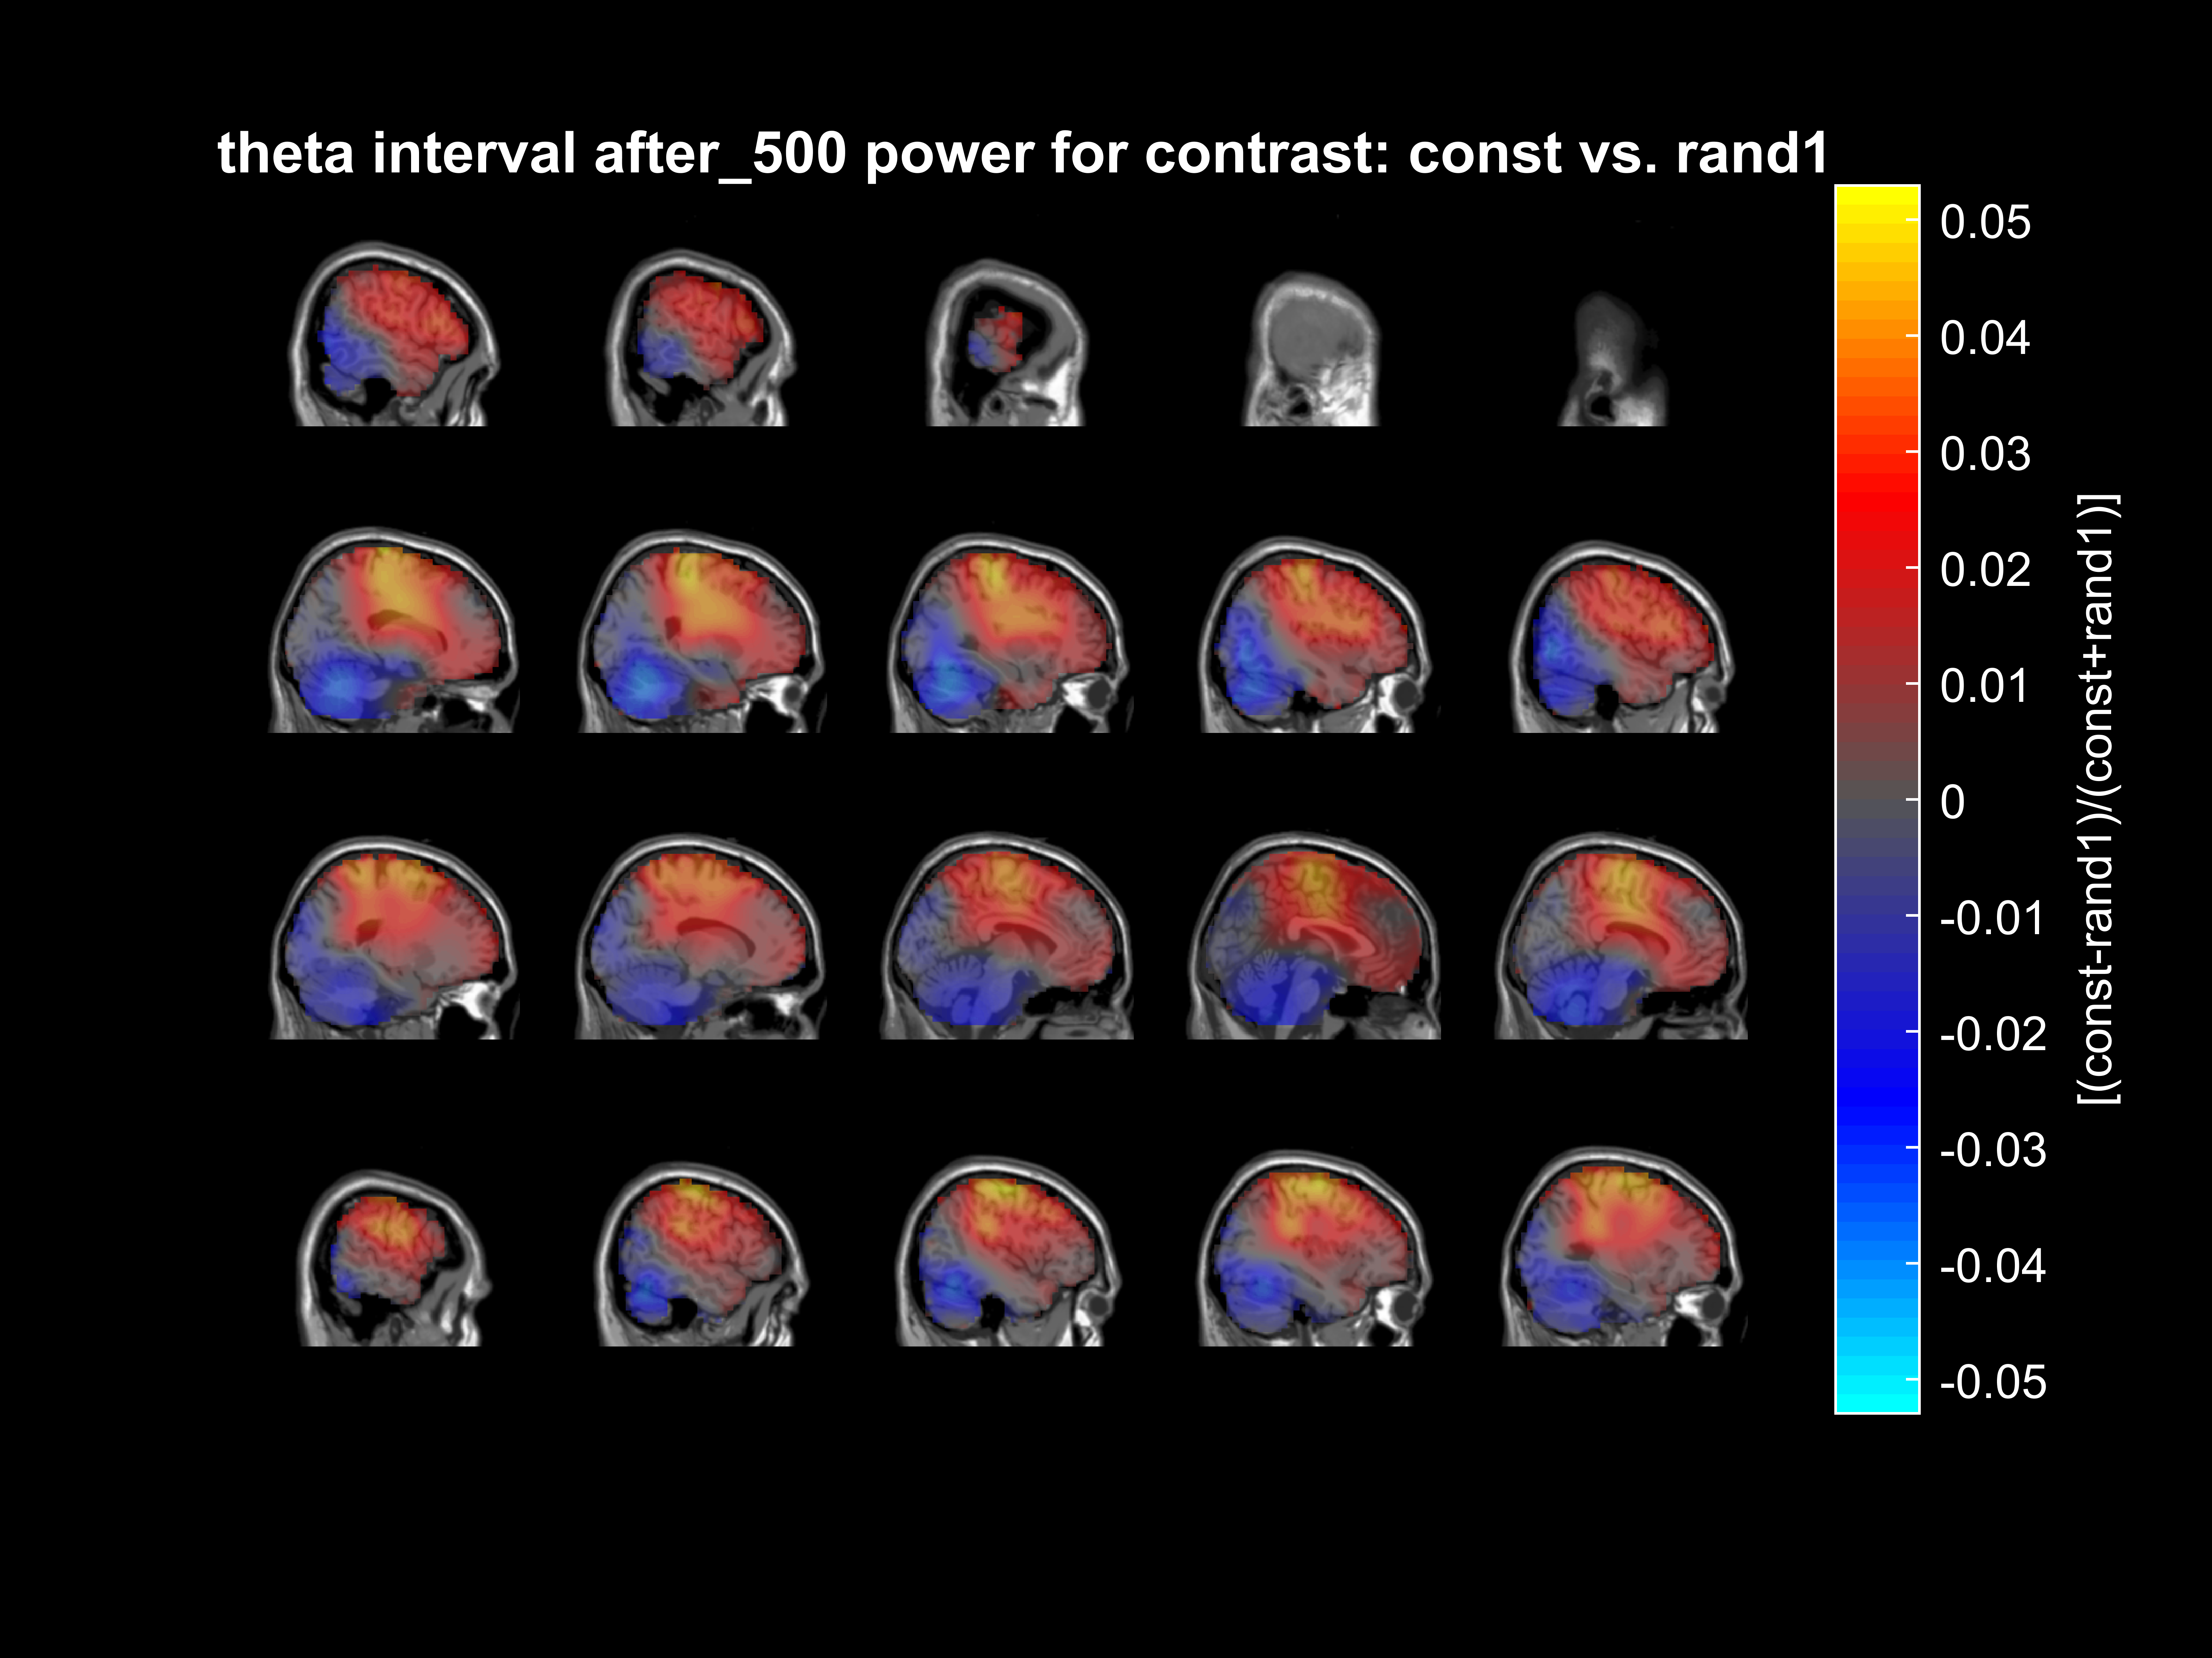
Task A: theta power
First 500 ms of const vs. rand 1
Significant time window: 0.068-0.5 s
After first 500 ms , const vs. rand1
Significant time window (rand1):
0.92-1.944 s

Slide 9
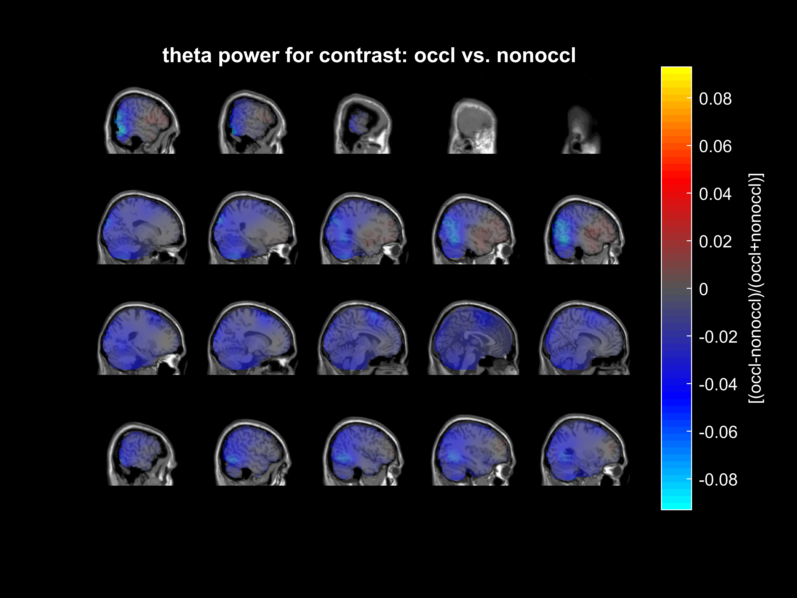
Task B: theta power – still to do: exclude first 500 ms
whole time window significant: 0-2 s

Slide 10
Next steps
Apply mask + thresholding → DBSCAN

